Slide 1
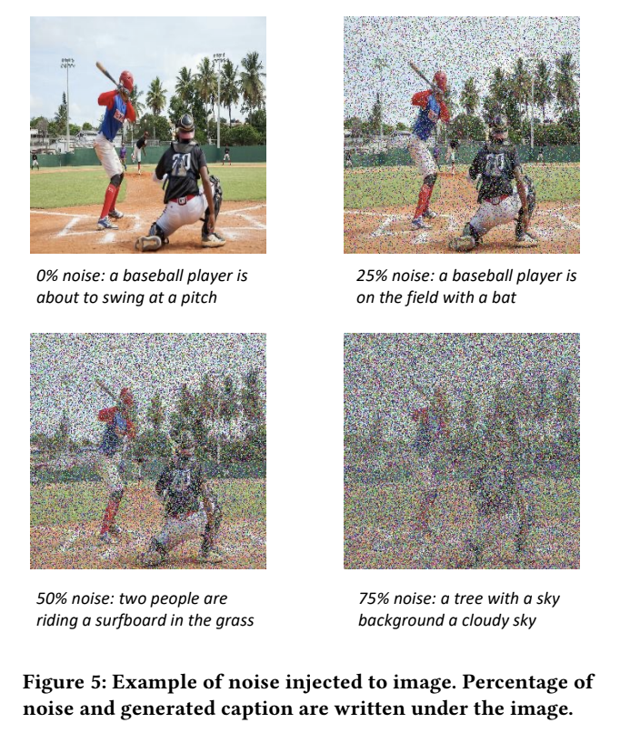
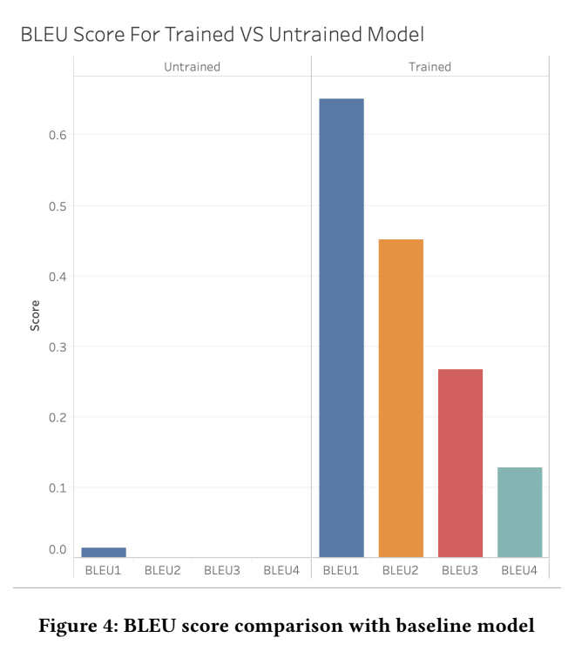
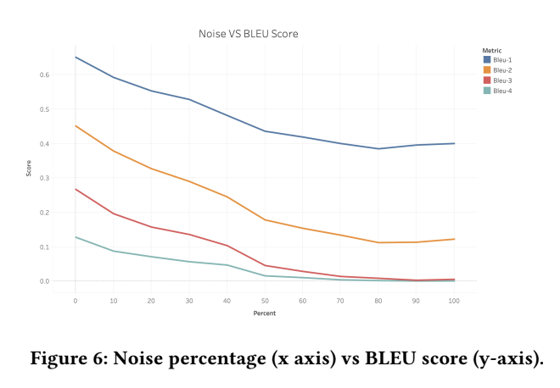
Image Captioning Using Vision Transformers
Problem: Understanding images/visual input can be difficult for those with visual impairment.
Approach: Using existing datasets (MSCOCO, FLIKR30k) we can train an image captioning model and investigate robusticity by changing pixels
We evaluate the model using the BLEU score
Status: Project is completed and results are below

